Slide 1
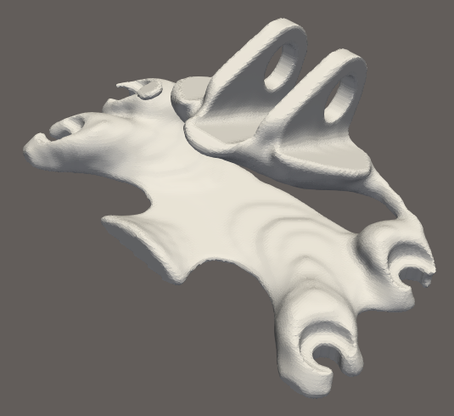
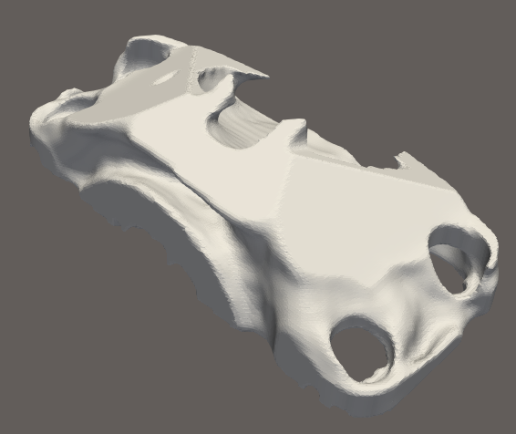
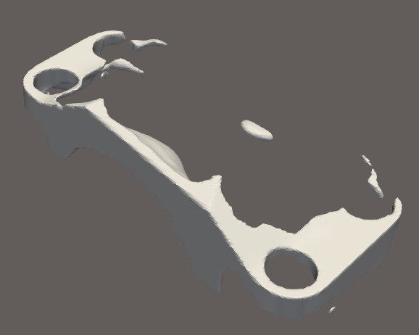
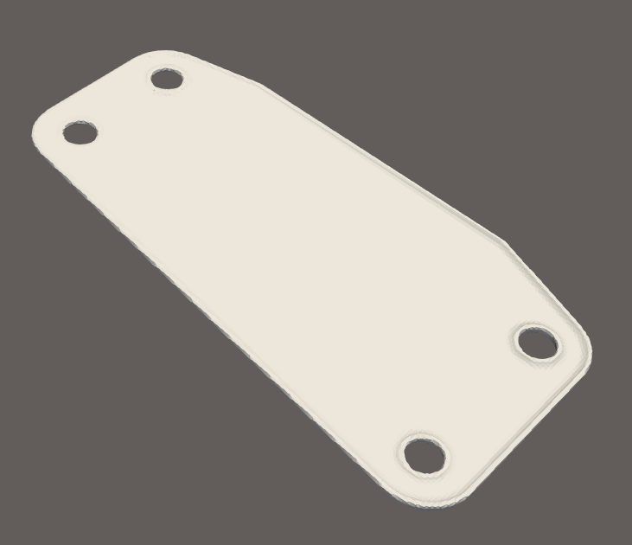
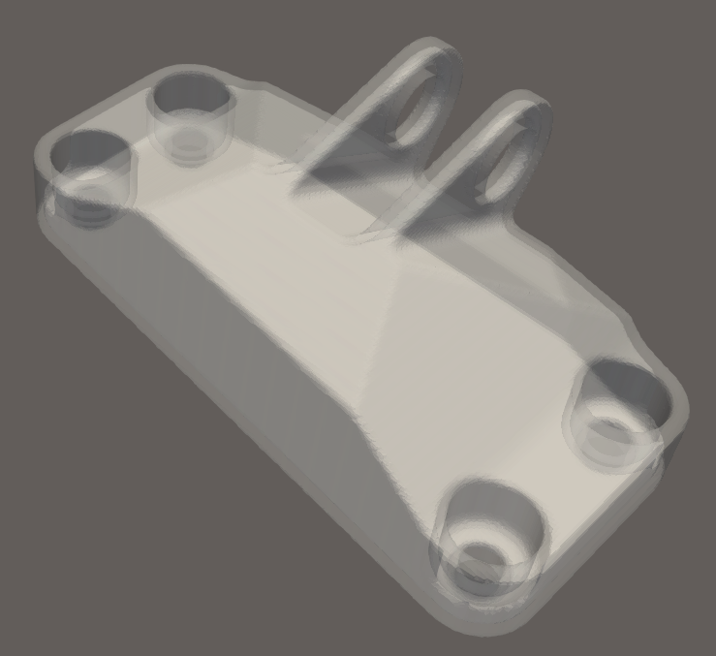
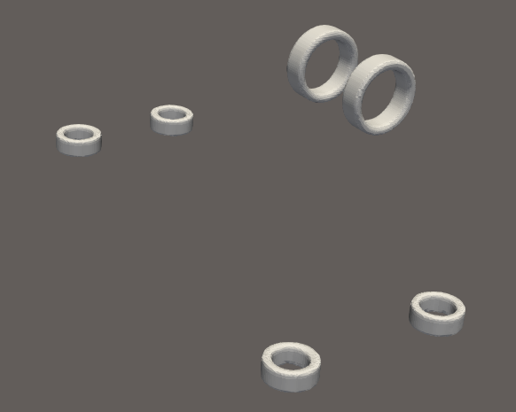
Initial
Optimized
Zone 1
Zone 2
Zone 3
Zone | Laser speed (m/s)
1 | 2
2 | 2
3 | 2
4 | 2
5 | 2
6 | 2
Zone | Laser speed (mm/s)
1 | 2.5
2 | 1.75
3 | 2.5
4 | 2.5
5 | 2.5
6 | 2.5
High-sensi
Med-sensi
Low-sensi
Zone 4
Zone 5
Zone 6
Base
Boundary
Interface

